Slide 1
Squeezing Theorem and Differentiability
Md Saif Kabir,
Lecturer, OAA

Slide 2

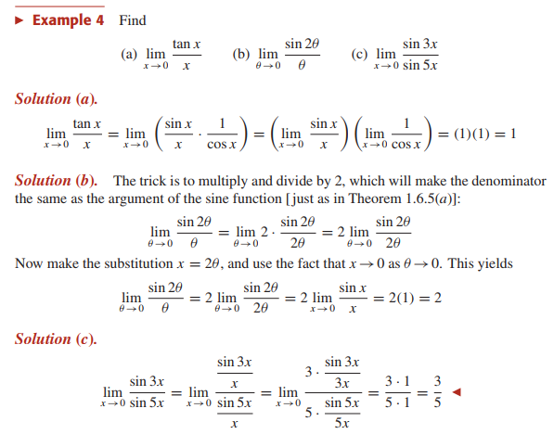

Slide 3
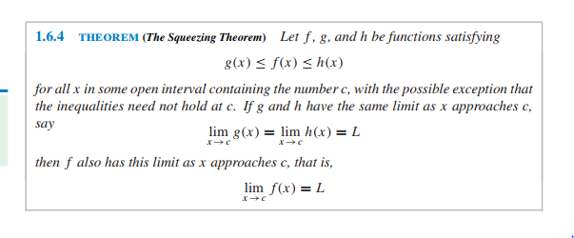
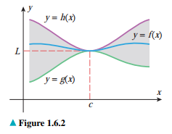

Slide 4


Slide 5
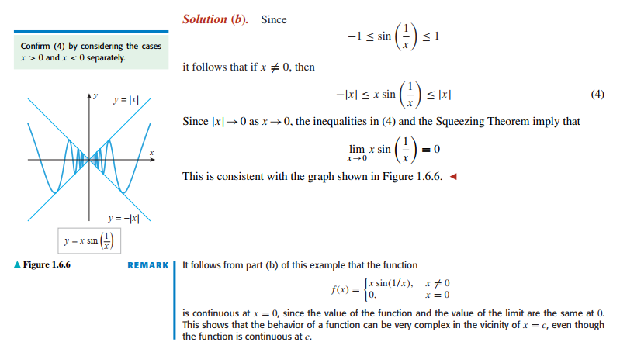

Slide 6
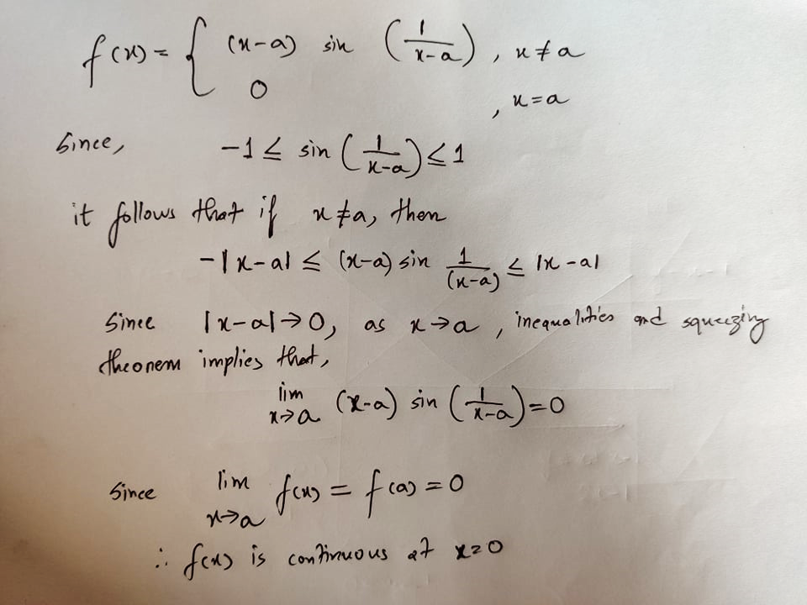

Test the continuity of the following function:
At x=a

Slide 7

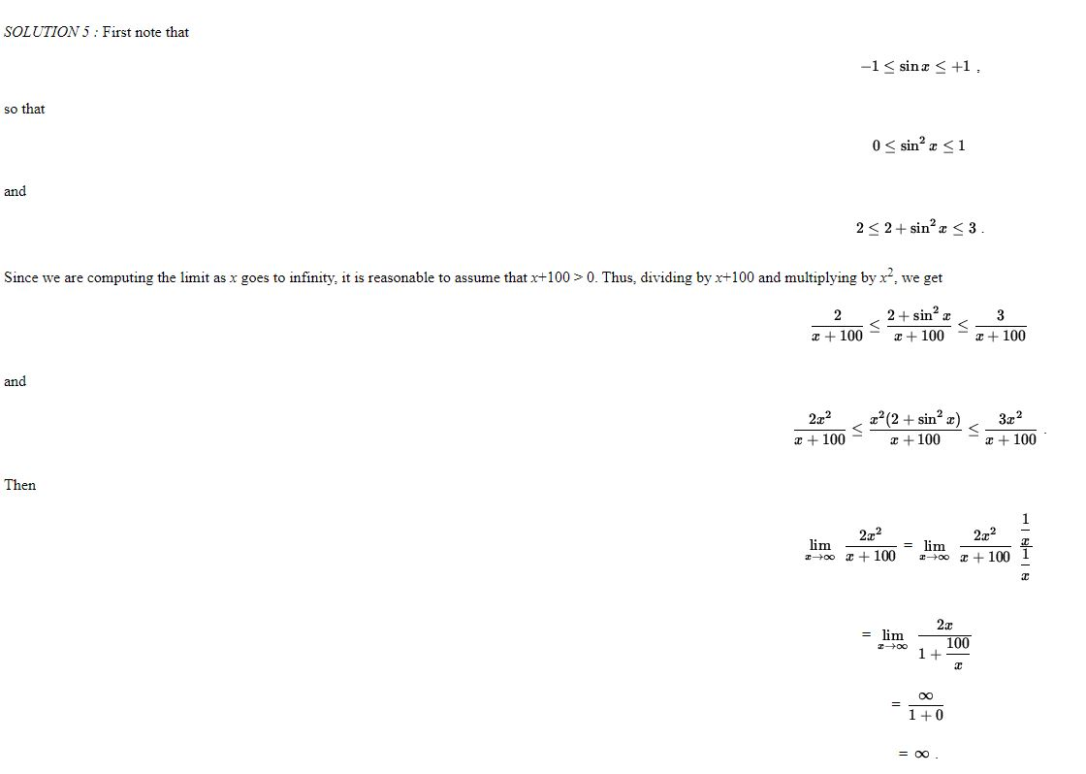

Slide 8
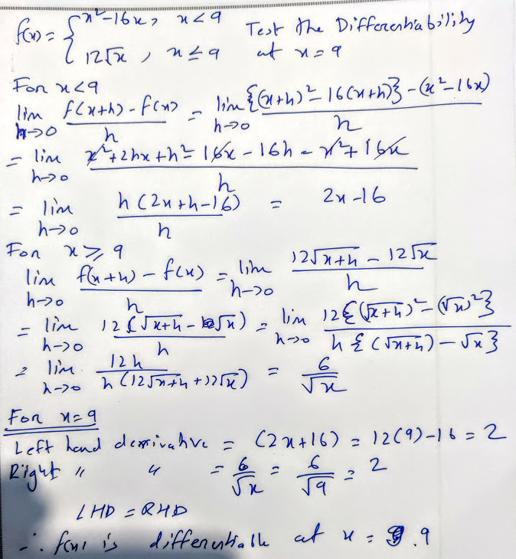
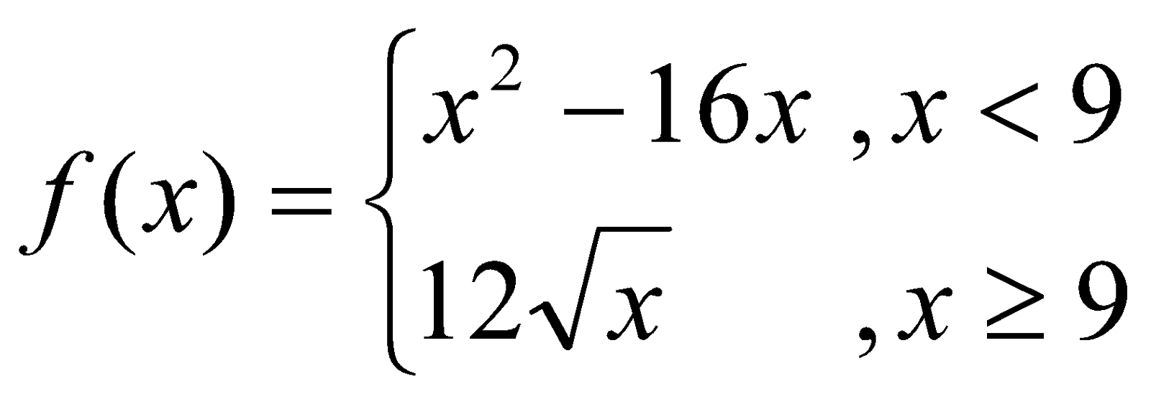
Determine the differentiability at x=9?

Slide 9
